Slide 1
Fuelmart & Subway safety committee meeting
8.19.20

Slide 2
Attendance
Please take a moment to add your first and last name and store number to the comment section.
We will begin shortly
Thank you!

Slide 3
July Review
How to ensure customers are attentive at the pump
Helen shared her experience with shutting off the pump, saving her store from having a spill, educating the customer as to the dangers of walking away from the pump.
Filling out your incident reports thoroughly and accurately

Slide 4
Incidents 7.22.20 – 8.19.20

Slide 5
7.26.20 FM 645 Customer Spill
Customer drive off at pump 4 causing an approx. 2.5-gal spill.
FM employees were able to clean up w/o assistance.
No damage reported.

Slide 6
7.27.20 FM 787 EPA Reportable Spill
Approx. 190-gal spill.
Offloading w/o observing the process.
EnviroServe on site for remediation.

Slide 7
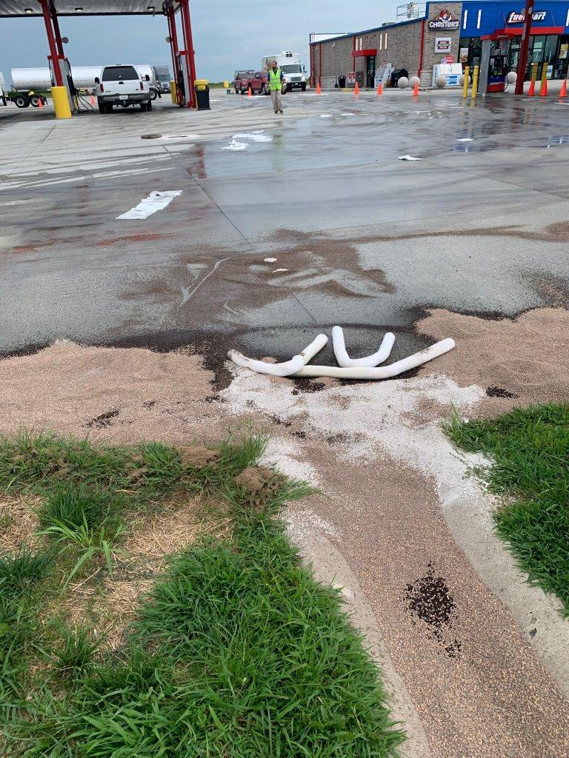
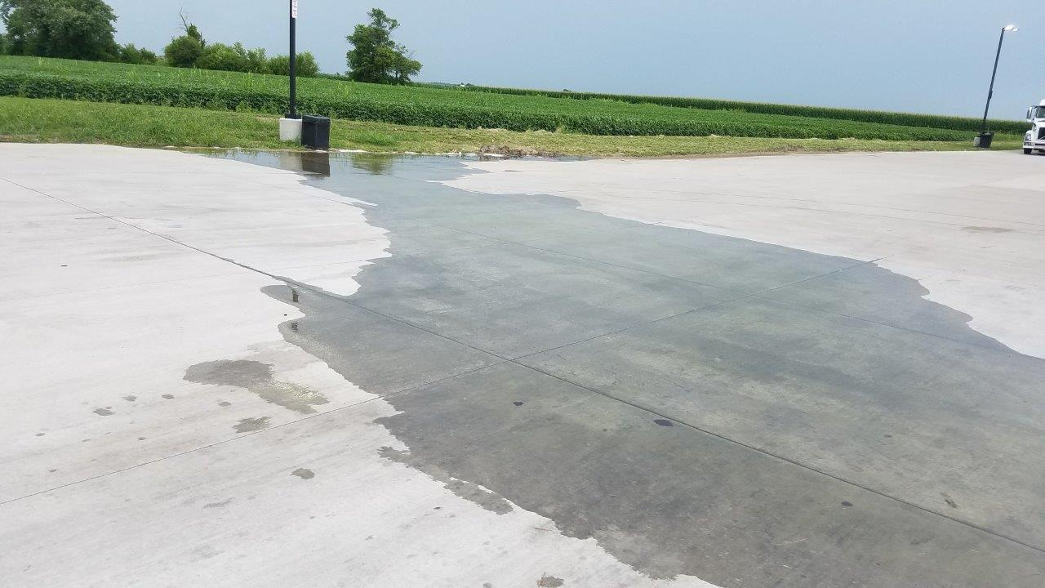

Slide 8
Procedures: What went right here?
Josh saw the spill > IMMEDIATELY reported the spill to the complex manager, Matt.
The two began to contain the spill
Islands were shut down to prevent the spill
Phillip was notified and was provided all information he needed to provide the EPA within the time frame allotted.
Incident Report form filled out
Photos submitted

Slide 9
Fire7.28.20 FM 787 Vehicle Fire
Vehicle drives onto property and parks under the fuel canopy with smoke coming from under the hood. Three minutes later the vehicle catches fire. Employees put out the fire with extinguishers. Fire and Police departments responded.

Slide 10
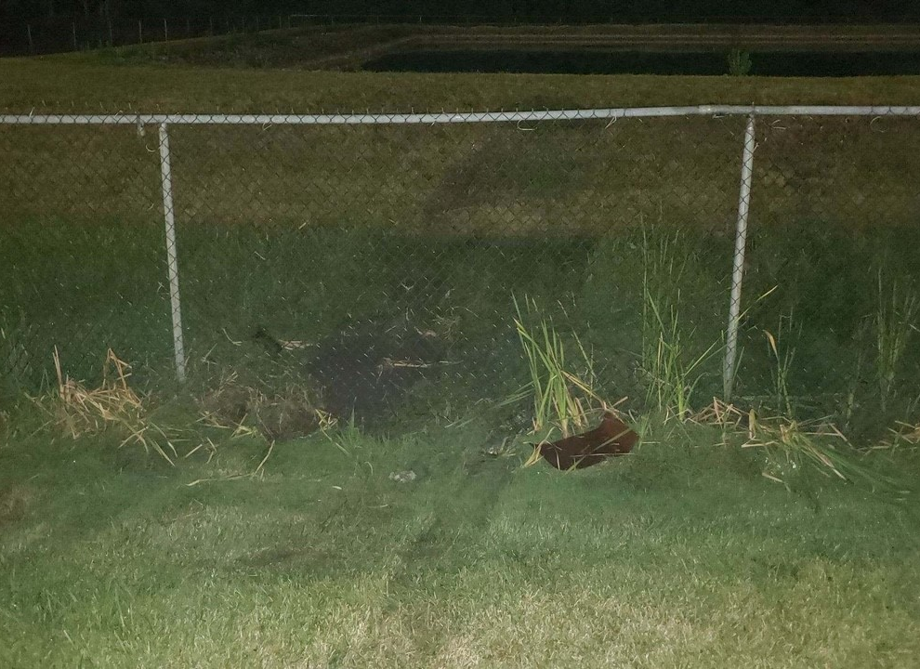
8.1.20 FM 767 Vehicle Incident
Vehicle being pursued by police drove onto FM property striking and going through the fence stopped on the hill beside the retention pond.
Occupants flee the scene; 1 on foot 1 ran into pond.
Pond occupant hosed off and arrested
2nd occupant apprehended later

Slide 11
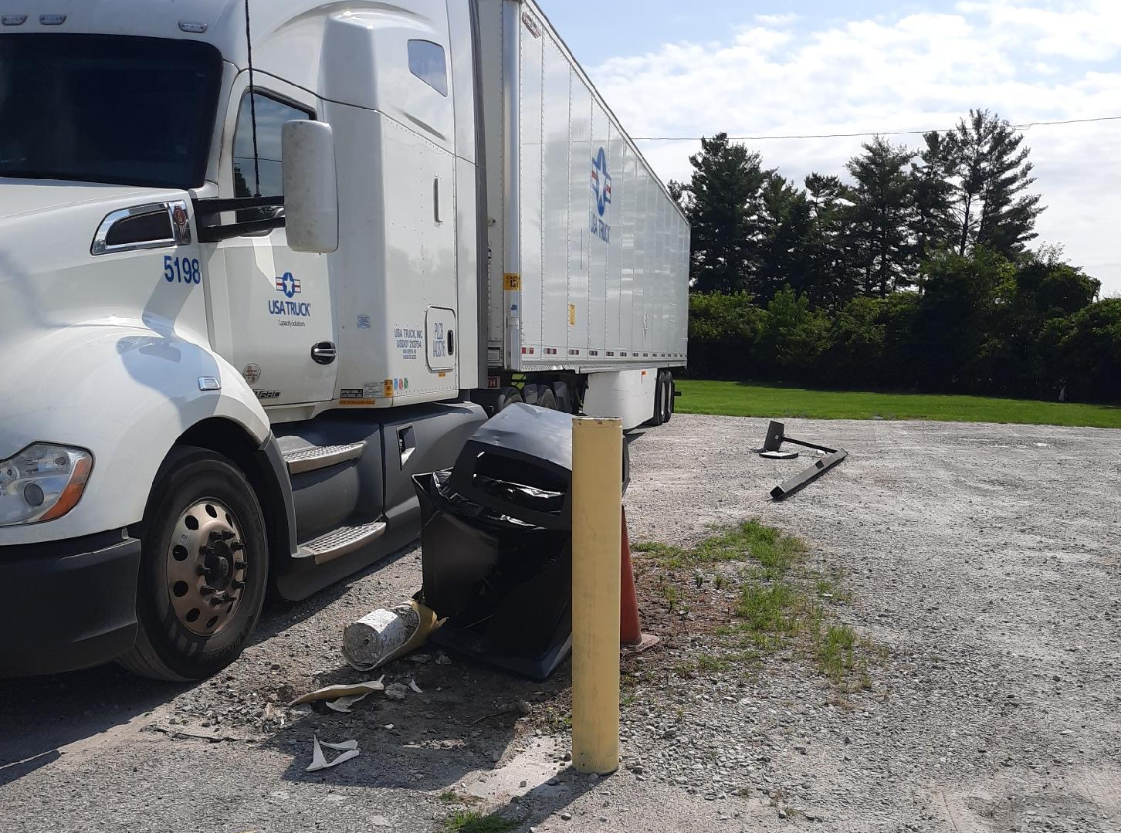
8.6.20 FM 783 Property Damage Great job Daelyn!!!

Slide 12
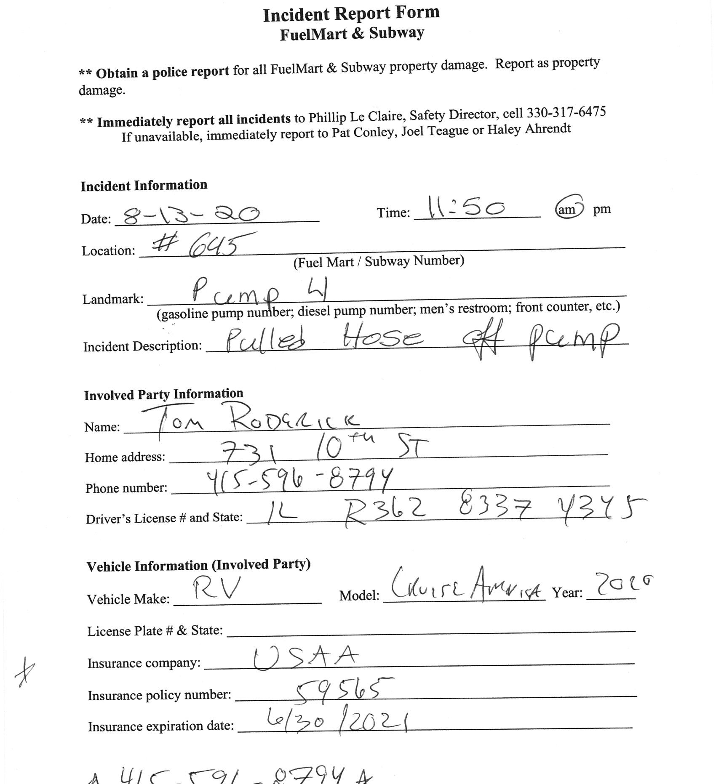
8.13.20 FM 645 Customer Drive Off

Slide 13
Employee Injuries
7.24.20 FM 764
Employee lost consciousness, fell to floor while stocking cigarettes. Said they over-heated and hadn’t eaten as the cause of the incident.
(Reporting Procedures)
7.24.20 Chester’s 427
Employee minor burn.
Incident Report submitted.
Thank you, Max, for being on top of it!
(Reporting Procedures)

Slide 14
Customer Injuries
8.2.20 Customer Fall
(Reporting Procedures)

Slide 16
Incident Handling
Please refer to the Incident Guide when training your employees. It provides step by step instructions. If you need a new copy, let me know, I will email you a copy.
In the event of a spill, use oil dry to contain and absorb the spilled product and sweep up. If it is a considerable amount you can squeegee the product into your oil/water separator (ONLY IF YOU ARE 100% SURE IT IS A SEPARATOR and not a drain) then clean up remaining product with oil dry and broom. Do not use water to spray product into the separator, this adds the amount of fluid entering the separator which can lead to overflow and product then entering waterways.
Until the product is cleaned up, use your cone and/or caution tape to keep customers from walking/driving through the spill.
If your spill is larger than 6’X6’ or 5’X7’ you will need to contact Phillip to report the spill.
Any time a spill is too large to handle or entering a drain, ditch, manhole cover call Phillip immediately.

Slide 17
Incident reporting
The original employee witness to an incident should be reporting directly to Phillip. His information along with the incident packets should be readily available to all employees. If it is not, fix that. Employees must be educated where to find this information.
When filling out your incident form only include the facts. Make no assumptions. If it is a question you don’t know the answer to write “unknown”. Customers are not to fill out incident reports!
If/When a customer comes in to report a spill. Please be sure to go outside and look for yourself to determine if Phillip needs notification. It is extremely important to view the spill just to verify for yourself no waterways are impacted. The reason for this is that Phillip has very limited time to notify the EPA. 30 min!
When taking pictures of damage please be sure to take several pictures from different angles so that we can clearly see the damage. Take pictures!
We understand that incidents can be overwhelming, and it can be very busy. Please be sure to send in your incident forms in a timely manner. Our insurance requires us to submit claims within a certain amount of time of the incident.

Slide 18
Incident Training Points
Do you know where your incident Report form is?
Do you know what customer information you need? Name/Company/Contact info/Insurance
Do you know who to report an incident to for a spill/customer incident/Employee injury?
Do you know where the phone number is to report?
Do you know what to do when a customer reports a spill?

Slide 19
A note from your Safety Department
We would like the Monthly Safety Inspections to be filled out be employees. We’ve noticed overtime that the managers have taken over this task. Employees participating in doing the inspections will help educate where things are and keep and eye open for any defects.
Be sure to have a refresher with your employees on spill management/clean up.
Provide a dialog for dealing with customers when an incident occurs such as when a spill is reported and you are busy, notify the customer you’re working with “so sorry, I’ll be right with you, I just need to be sure it’s nothing serious”. Or when getting information from a customer “I understand. I just need to get some information from you, and we’ll get you on your way”. How you present it to the customer makes a huge difference.

Slide 20
Fuelmart & Subway 2020 Incident Totals:
Company Total: 130
FuelMart & Subway Total: 84
Employee Injuries: 14
Property Damage and/or Vehicle Incidents: 25
Customer Spills: 30 (21 at fuel pumps)
Customer Injuries: 13
“Other” Incidents: 2

Slide 21
Comments?
Questions?
Suggestion?
Feel free to call!!!
330.804.9155
Or email me with anything you may have to contribute!
lisa@portspetro.com

